Slide 1
Miranda Carson
MIT BSME E.I.T.
Mechanical Engineering Portfolio
mscarson@alum.mit.edu
(617) 802-1515

Slide 2
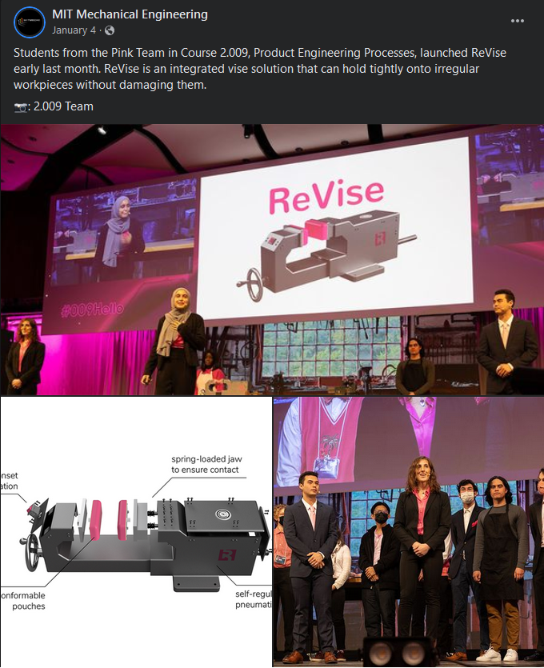
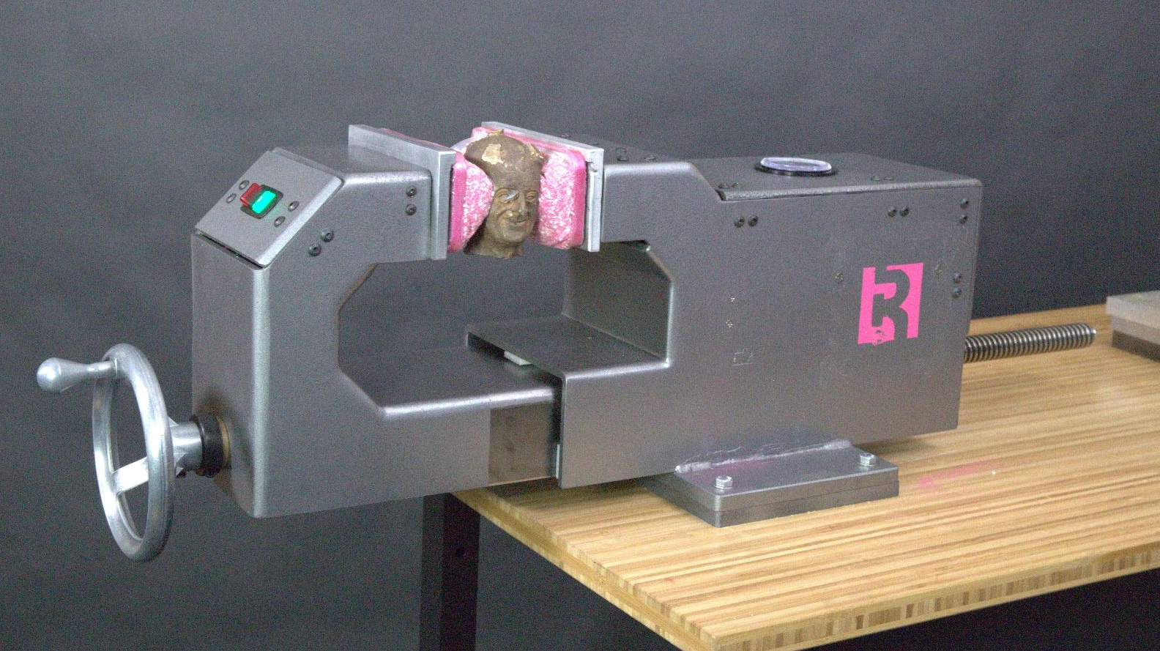
Classwork: Product Engineering
ReVise uses the concept of granular jamming to conform its jaw faces to irregular workpiece geometry, increasing surface area contact to maximize holding force and minimize damage to workpiece.

Slide 3
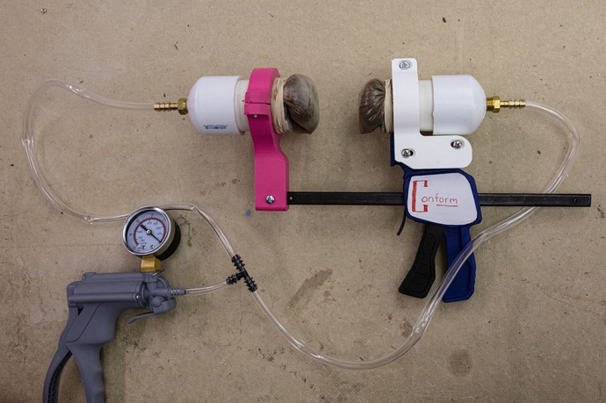
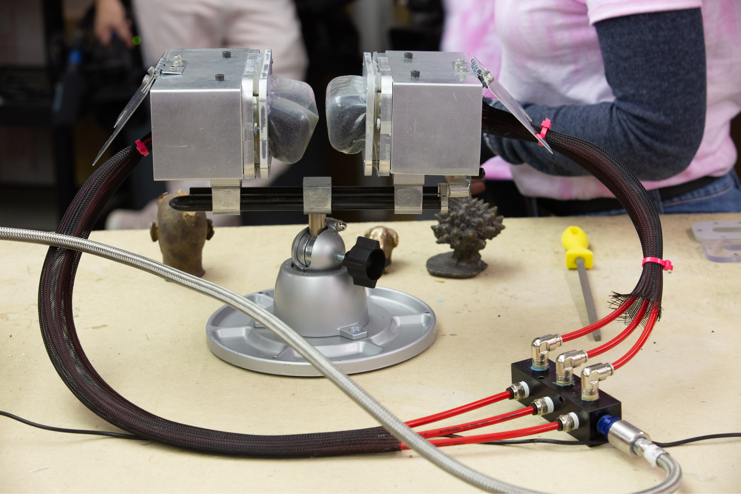

Slide 4
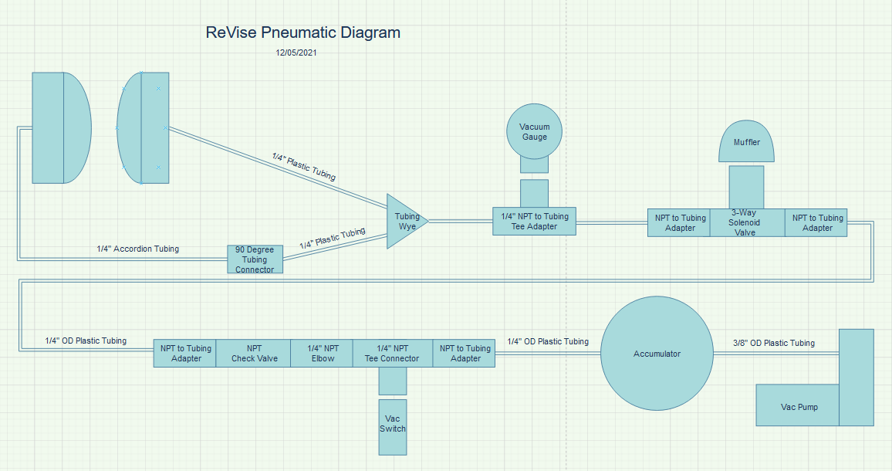

Slide 5
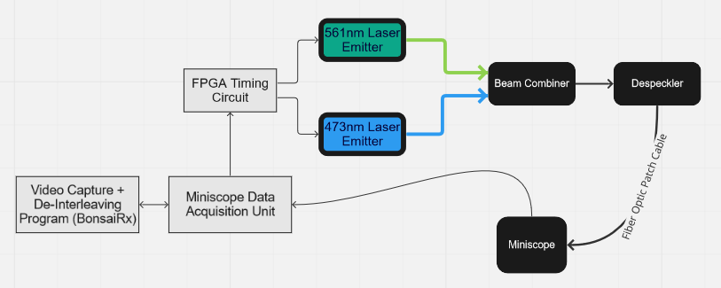
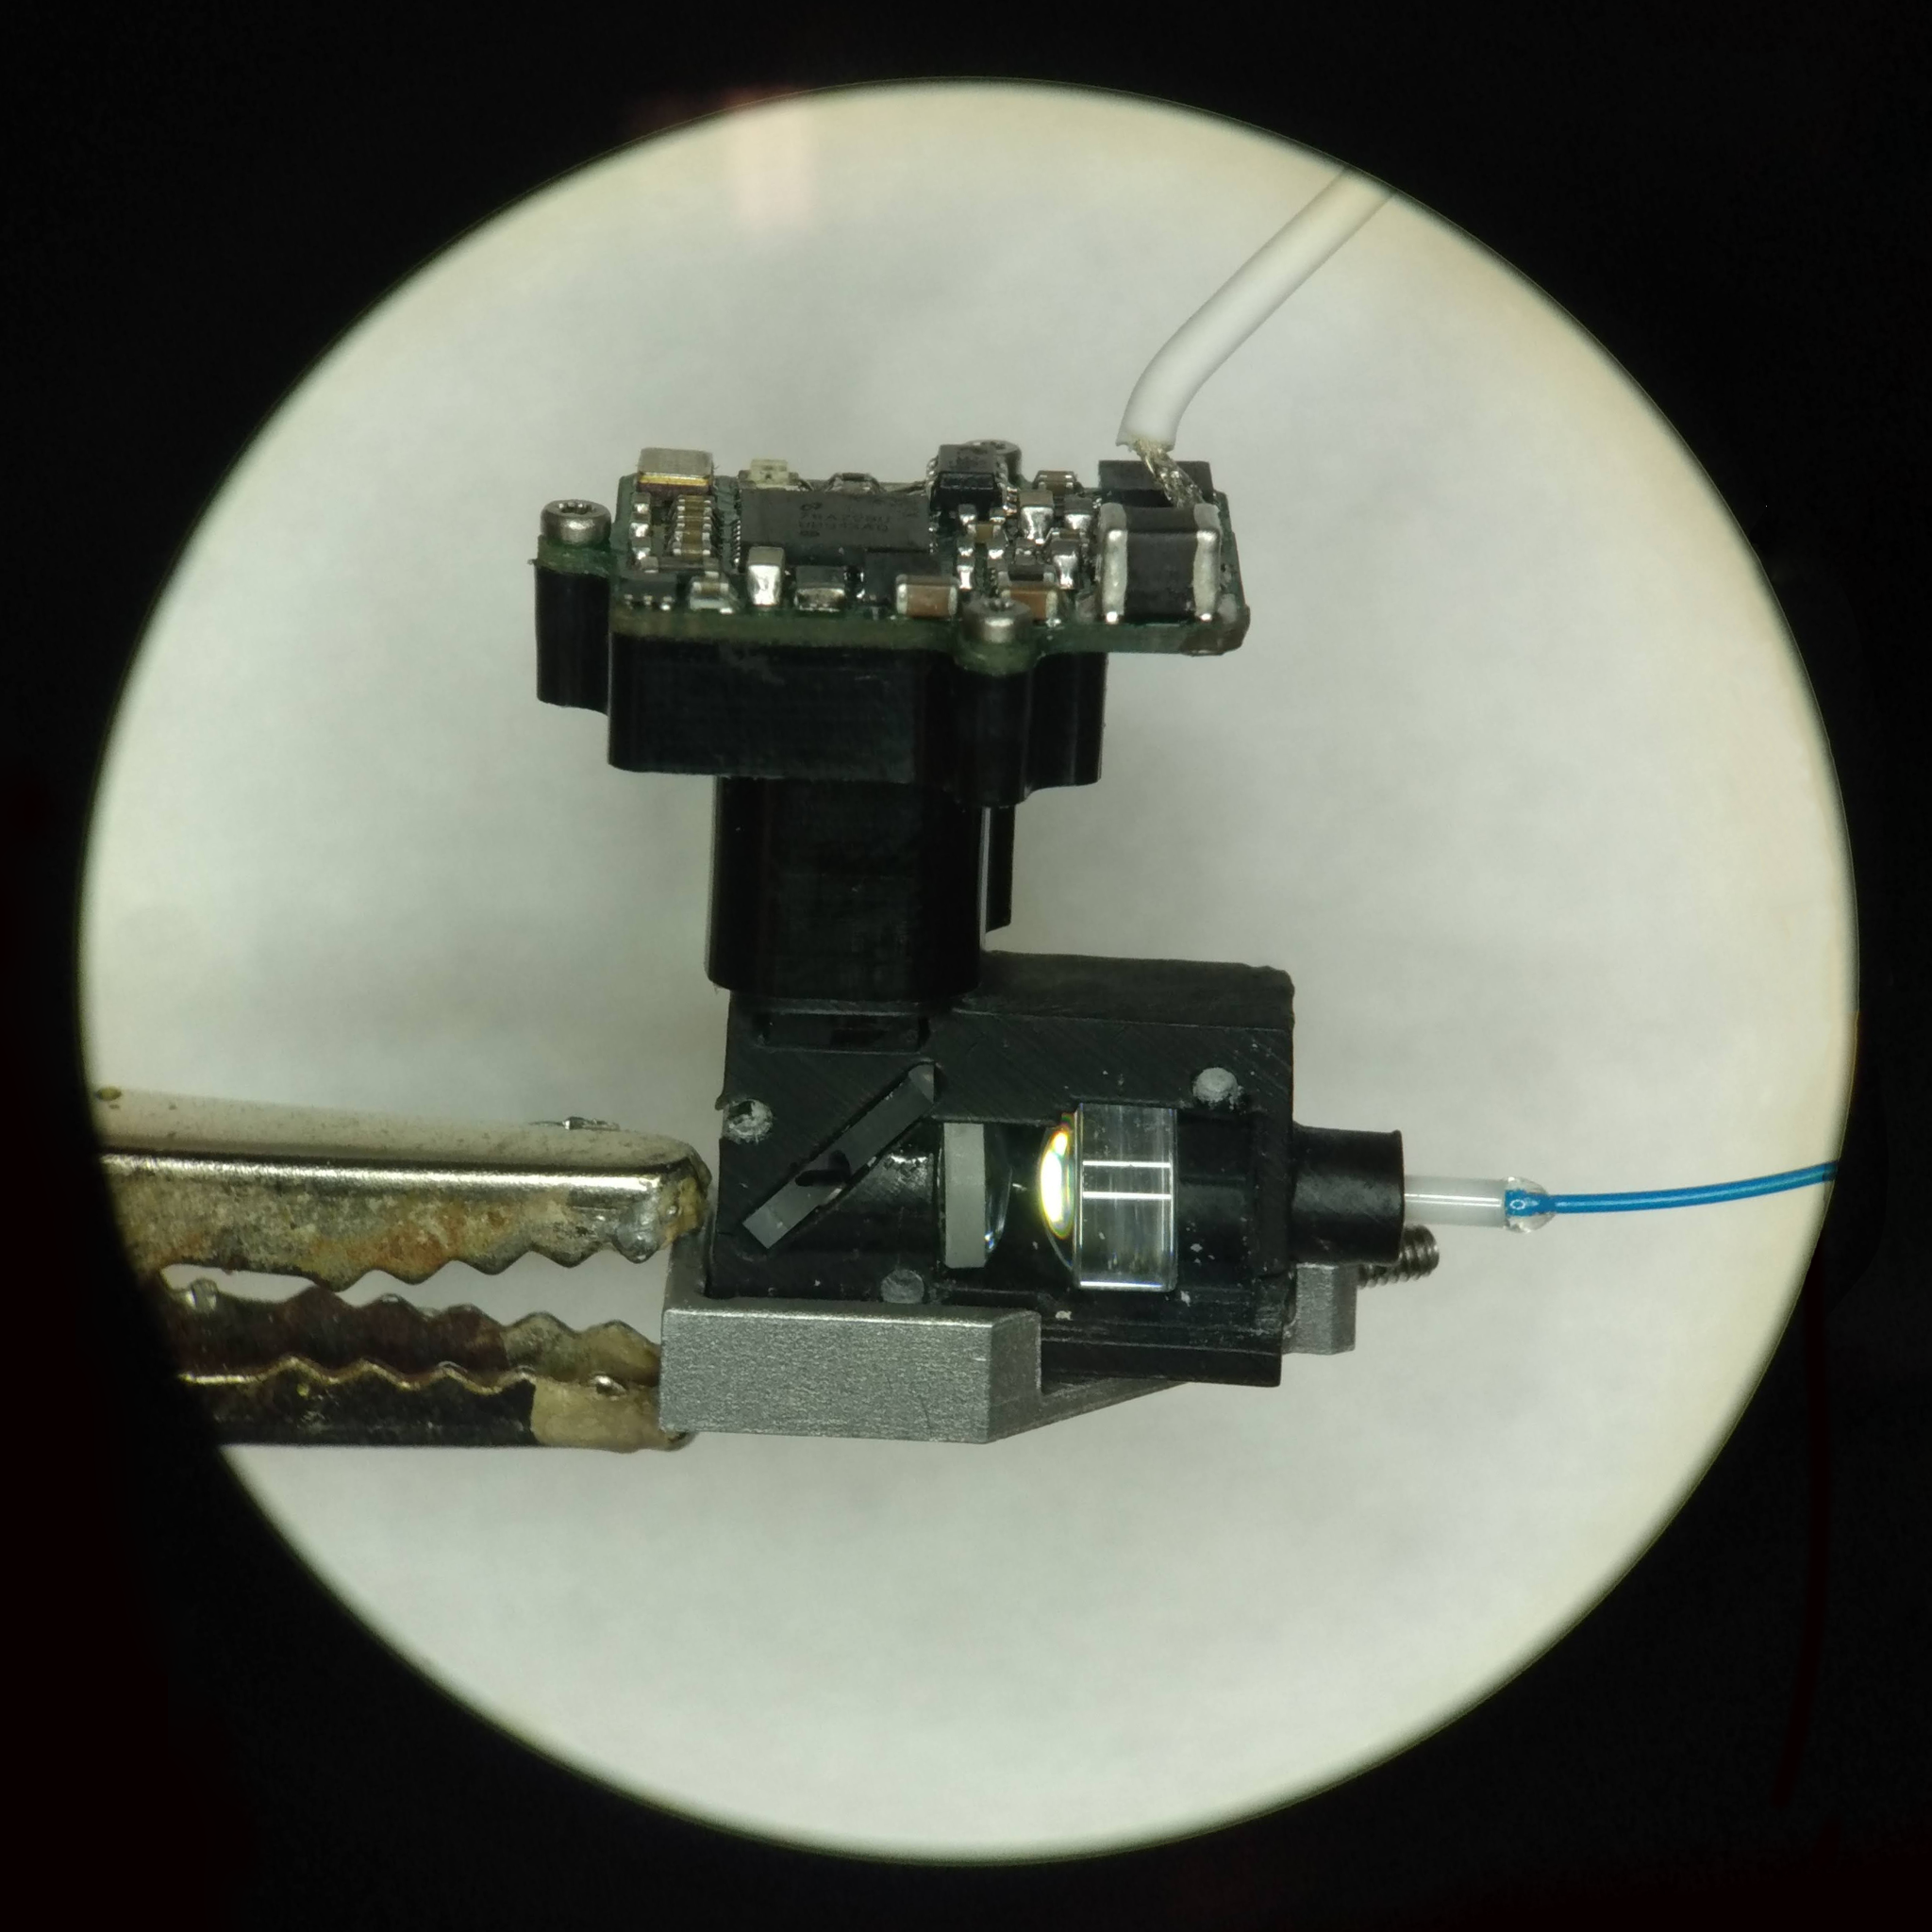
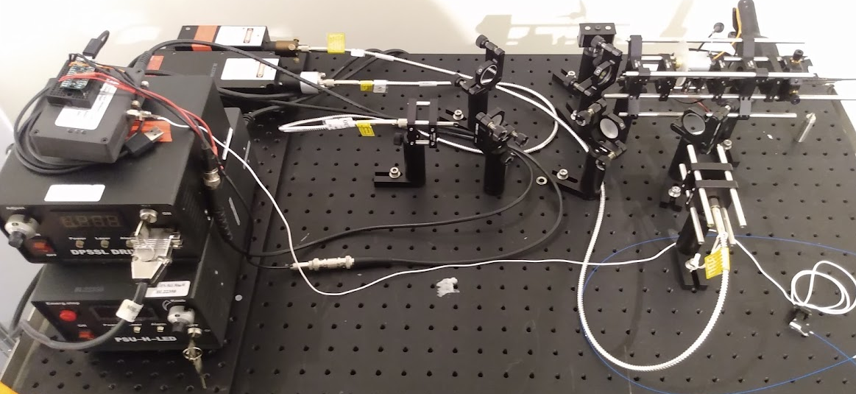
Two Color “Miniscope” Micro-Endoscope
Visualise activity from discrete neuron populations simultaneously

Slide 6
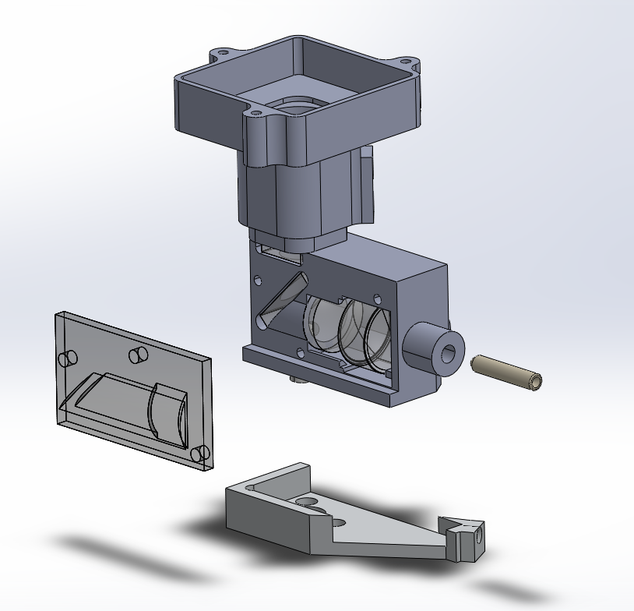
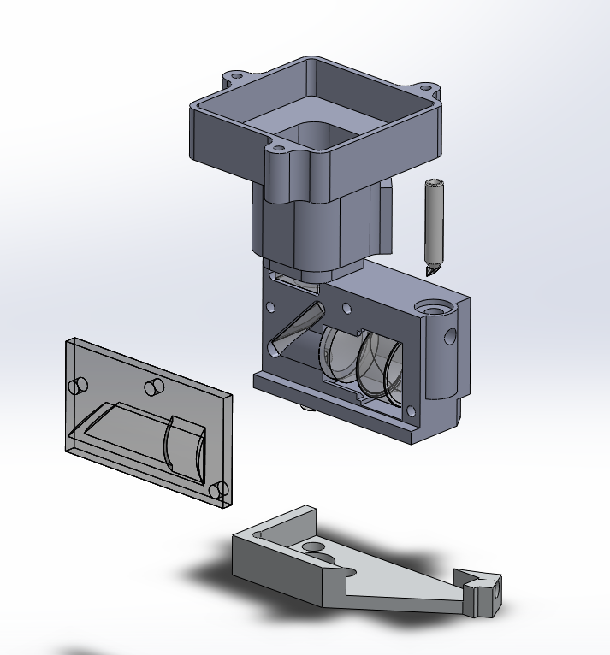
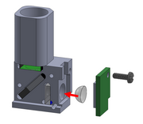
V1
- Simpler overall design
- Easier to align fiber ferrule
V2
- Fiber & coaxial cables aligned
- Less obtrusive to animal
- More precise assembly required

Slide 7

(Video)

Slide 8
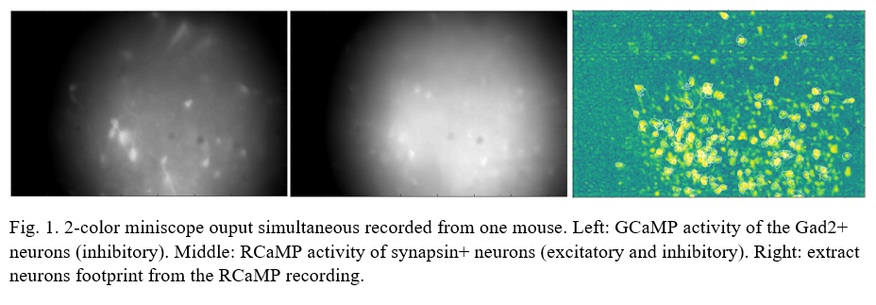
Two Color Miniscope is currently being used in live experiments

Slide 9
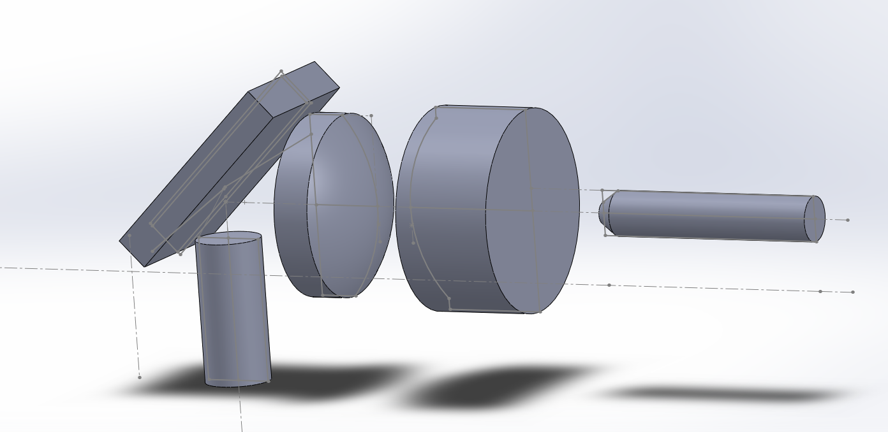
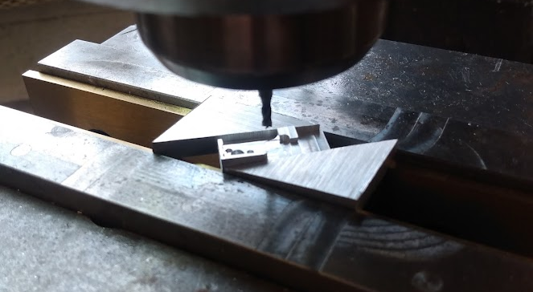

Slide 10
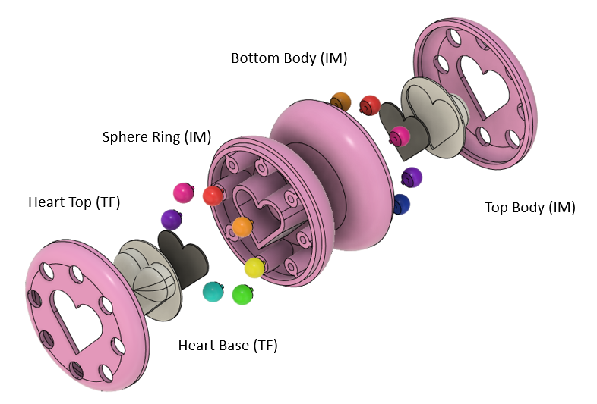
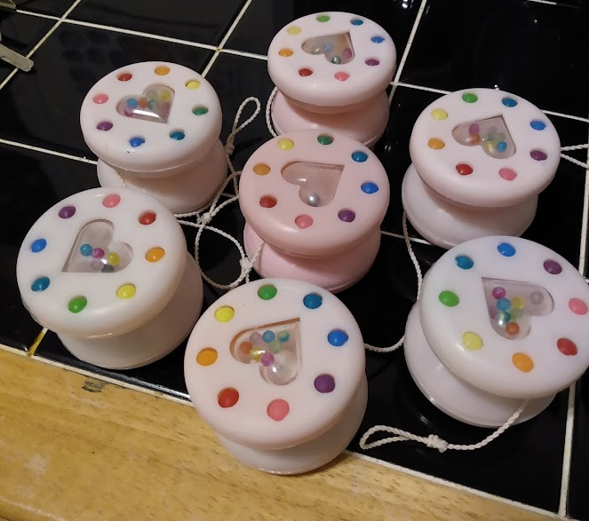
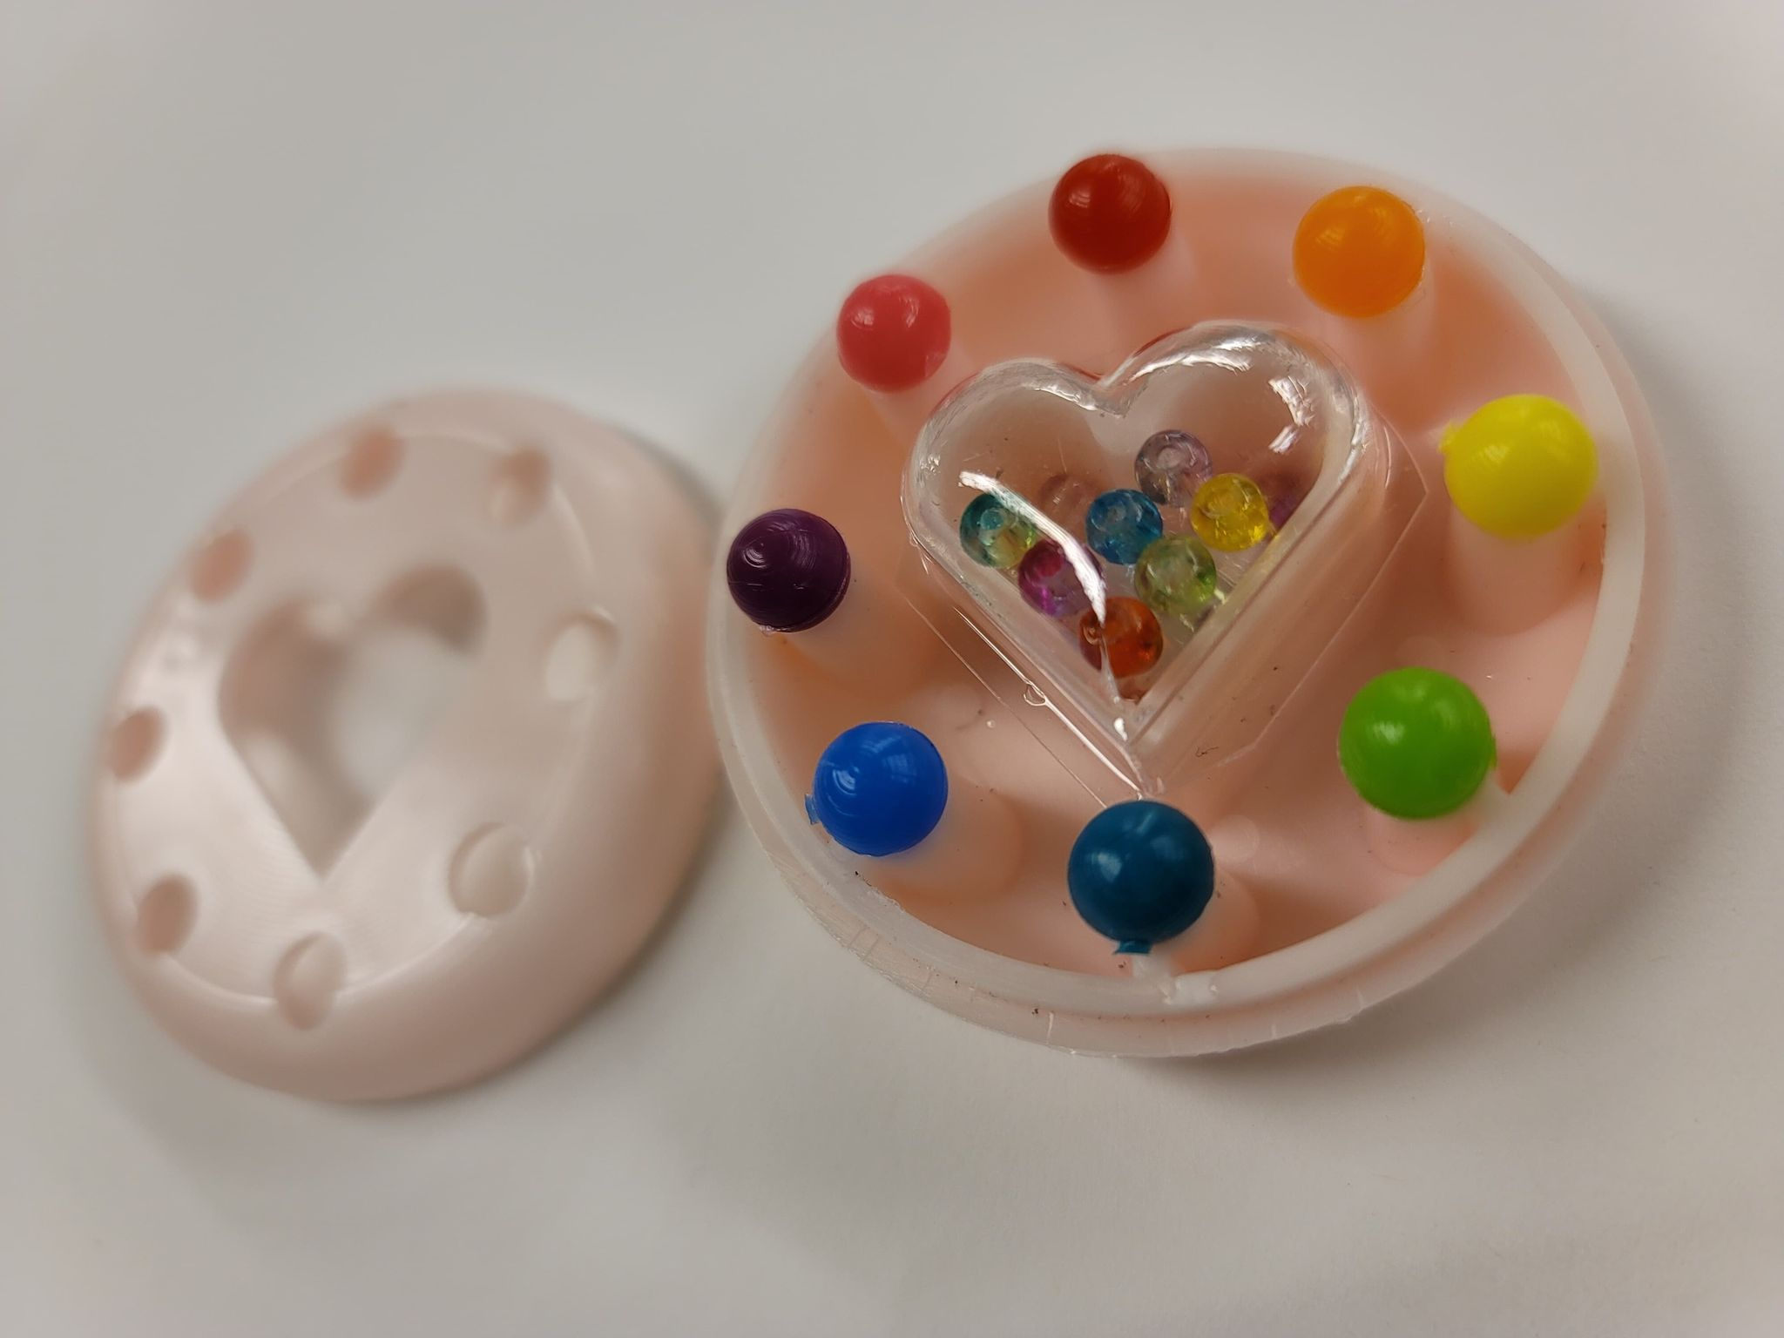
Classwork: Design & Manufacturing II
Produced 50 yo-yos as a team of 3 students, focus on fabrication processes, DFM, manufacturability, and tolerance analysis

Slide 11
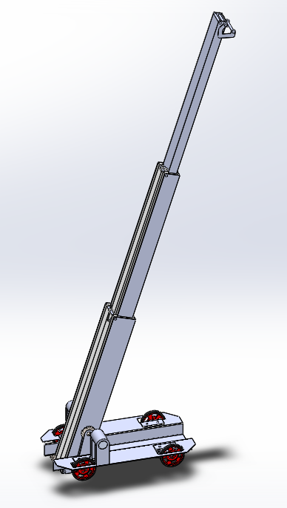
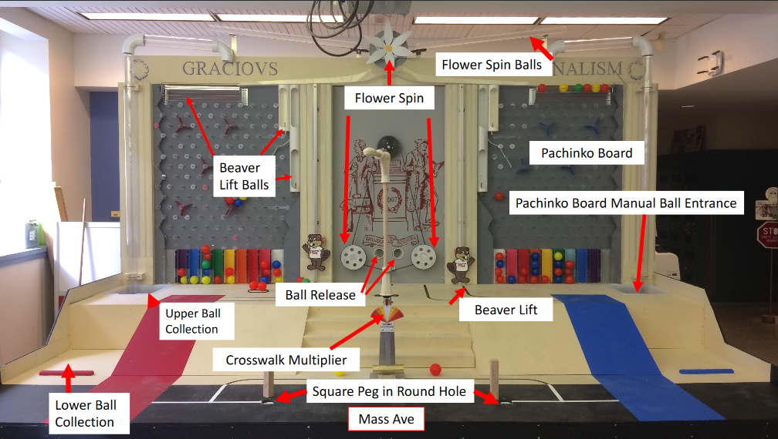
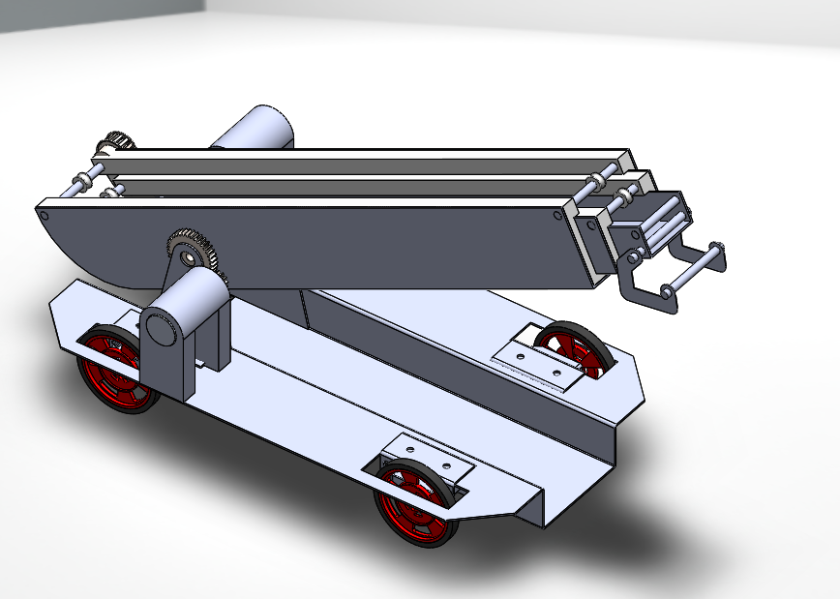
Classwork: Design & Manufacturing I
Competitive RC robot challenge on complex game board. Cars are designed & fabricated independently from raw materials in the class’ machine shop.

Slide 12
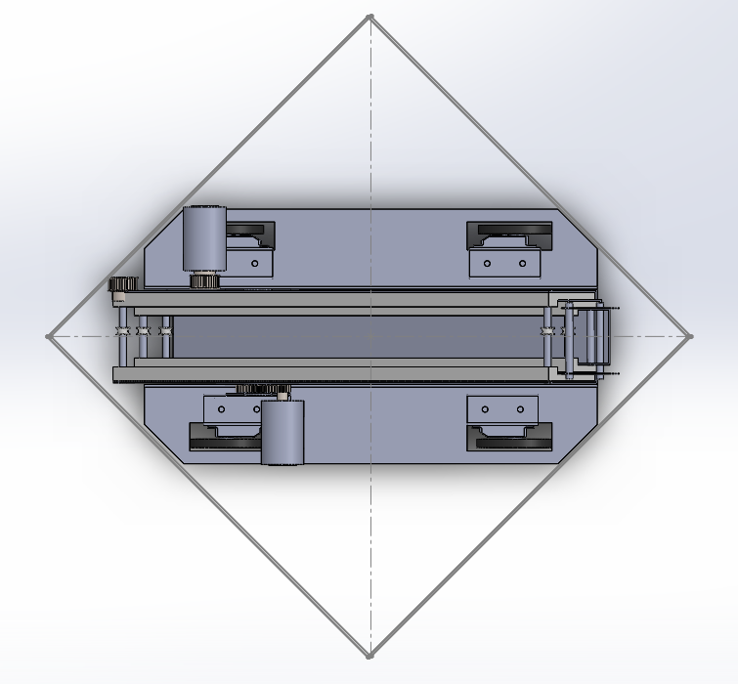
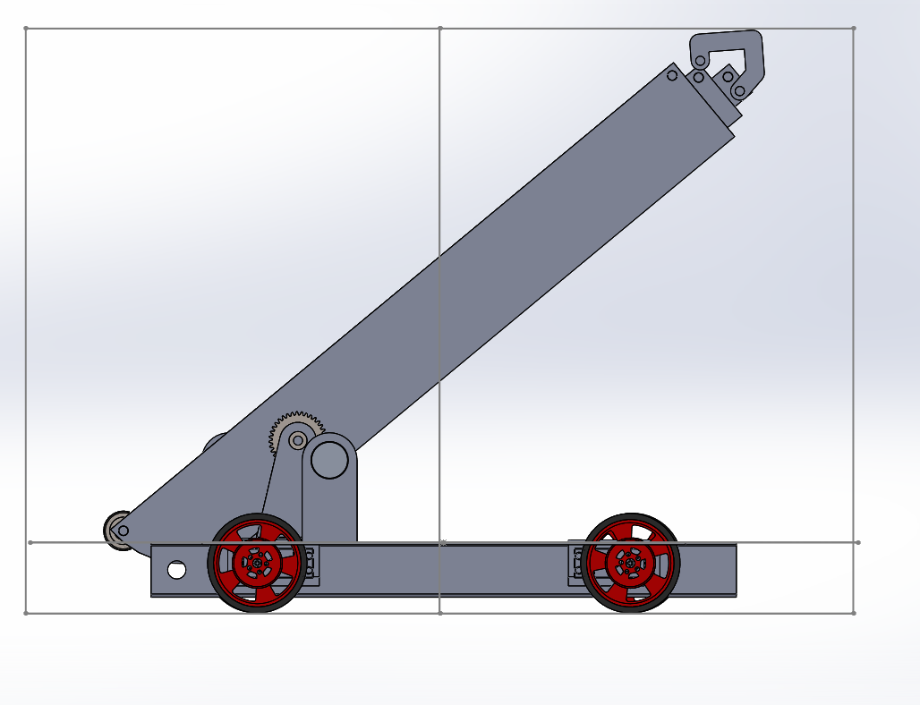
Hook
Winch Motor
Boom
with Telescoping Struts
Triangle Brackets
Boom Angle Motor
4 powered wheels (Spring RC)

Slide 13
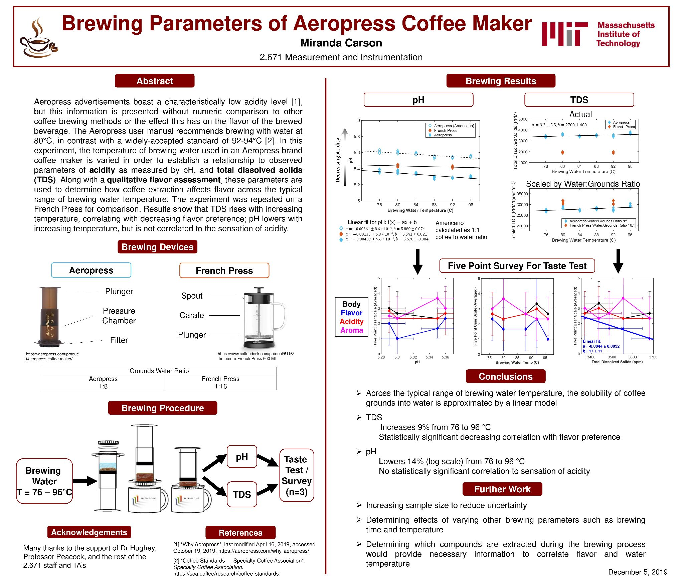

Slide 14

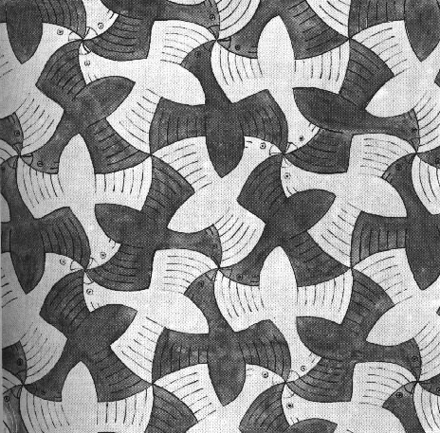
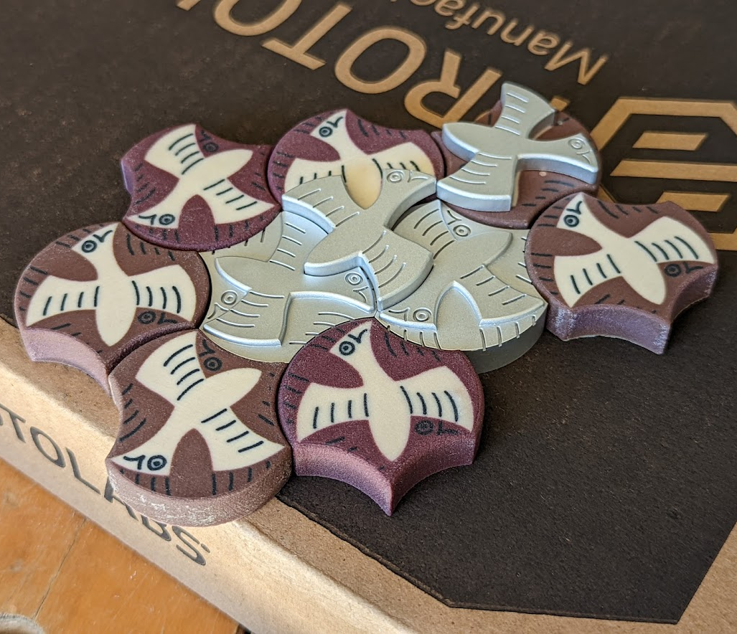
Design Solutions for Gemotions LLC
Escher-inspired Tesselating Candies

Slide 15
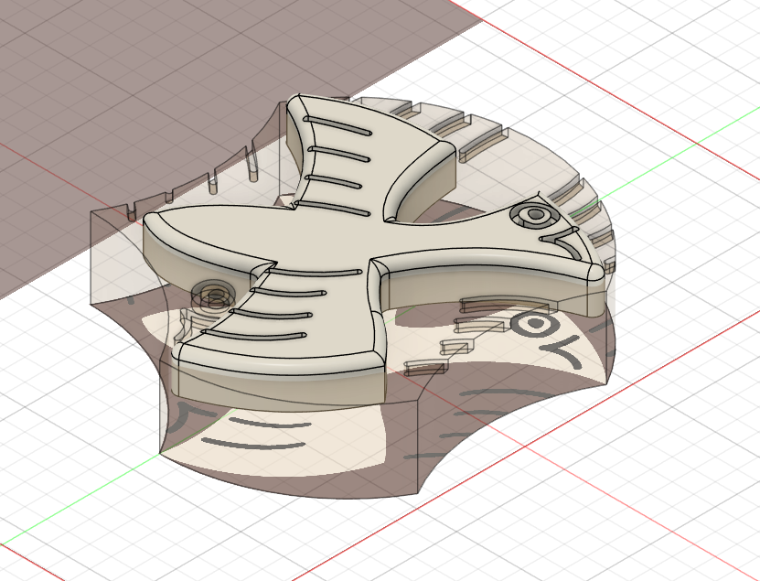
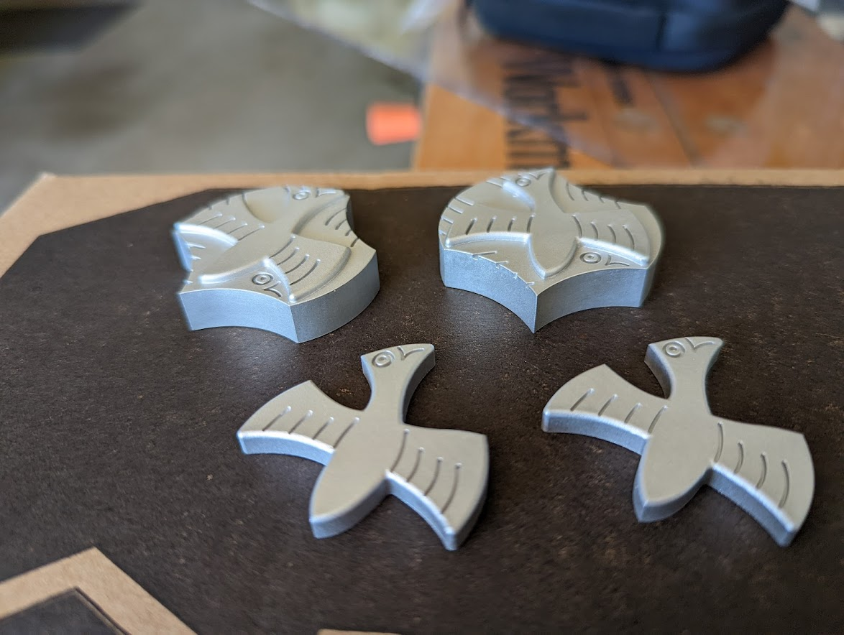

Slide 16
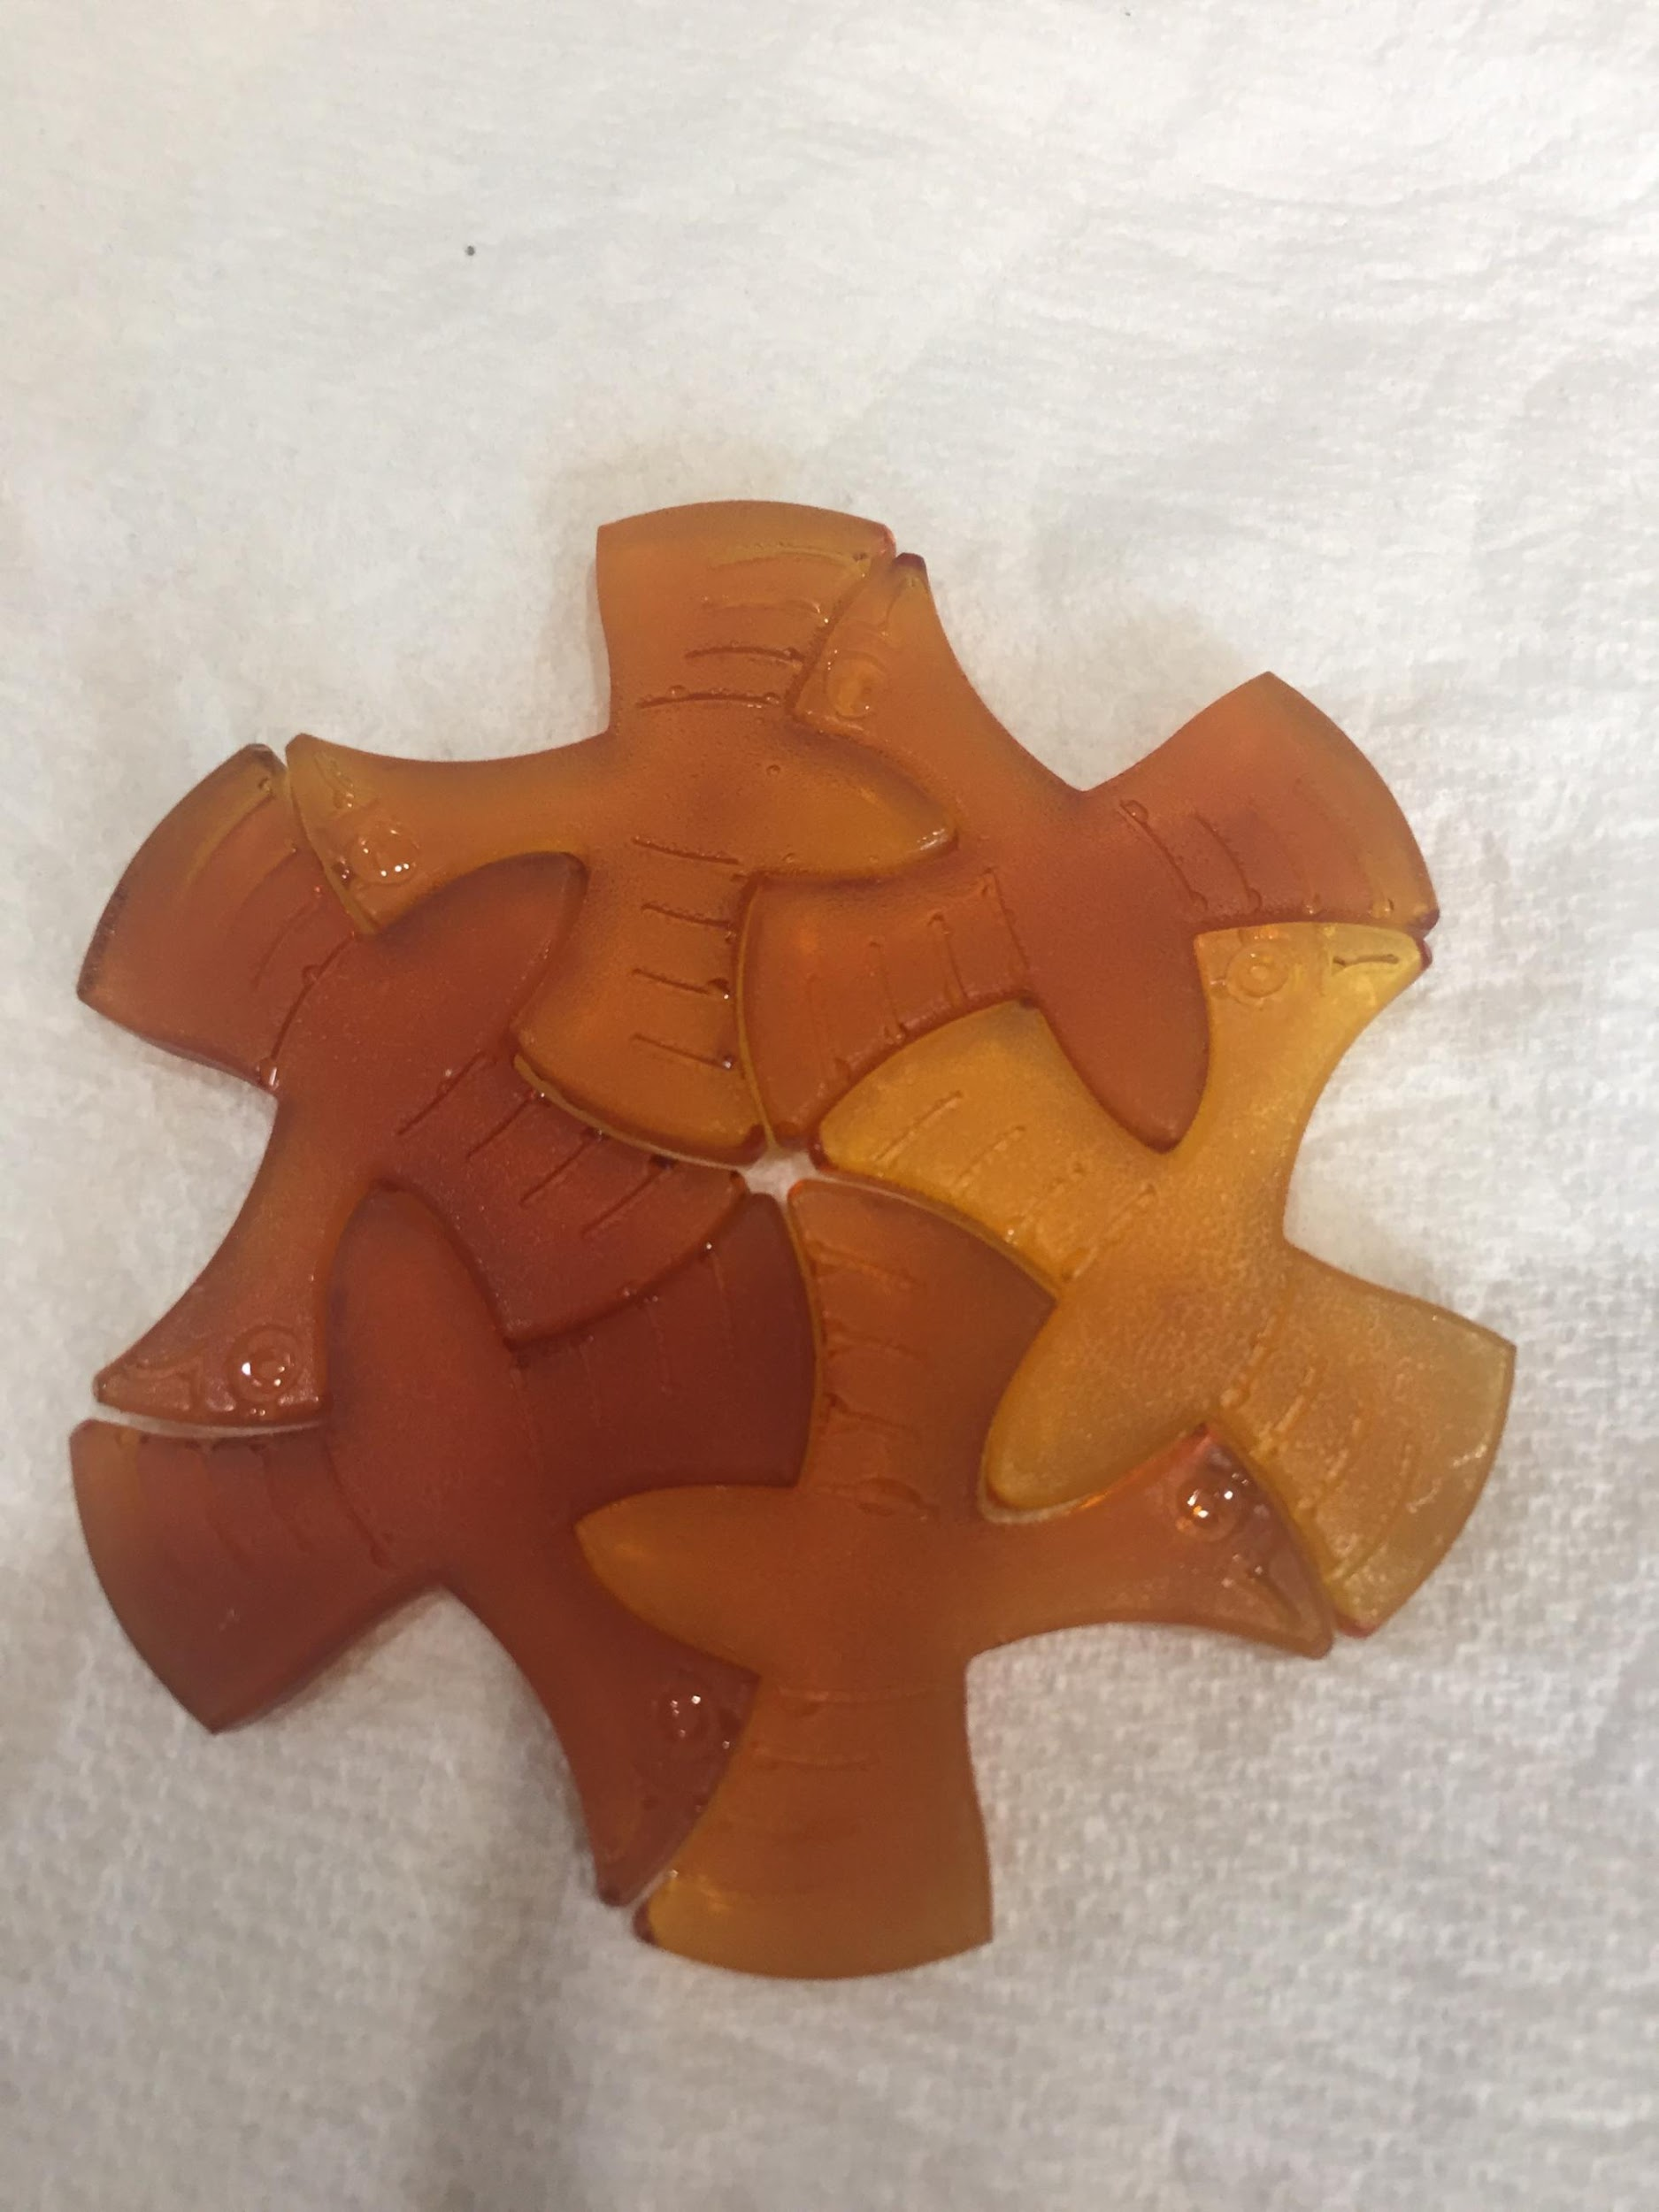
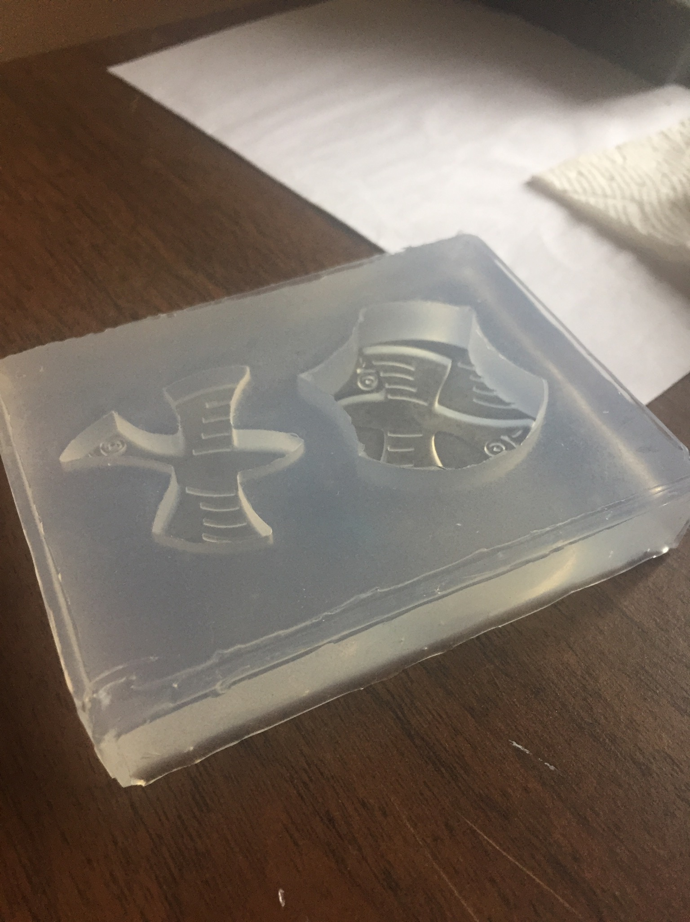
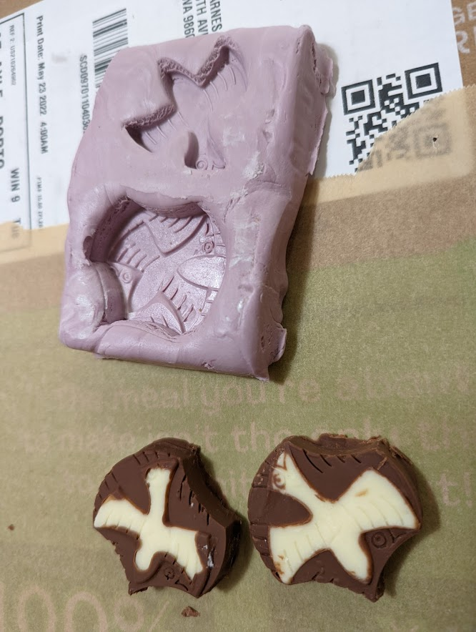
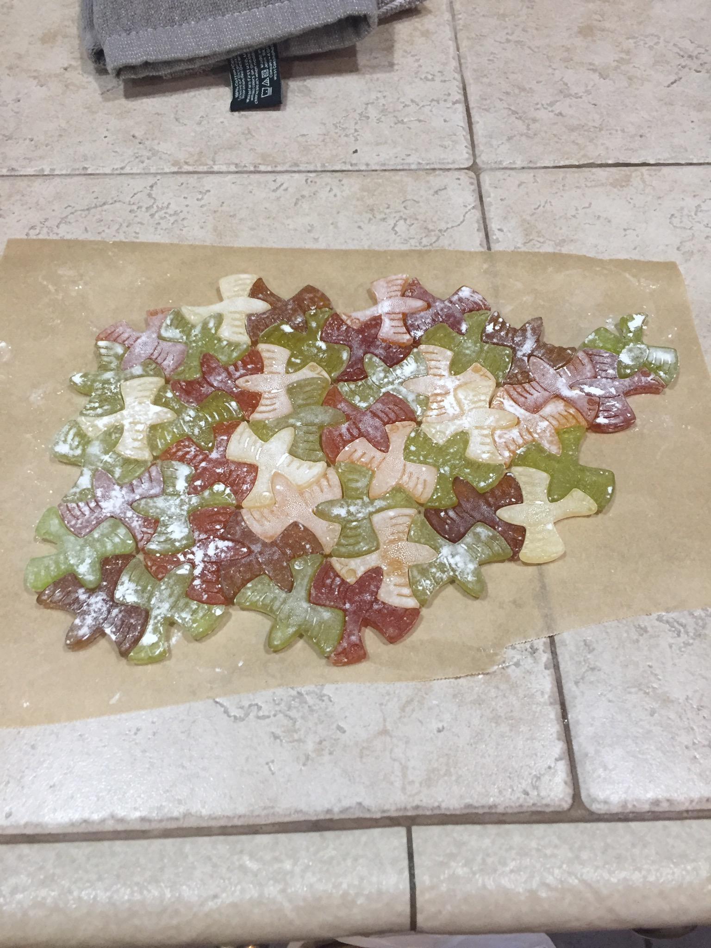
First pass, low cost validation of overmolding process with silicone molds
Materials: Chocolate, Caramel, Isomalt

Slide 17

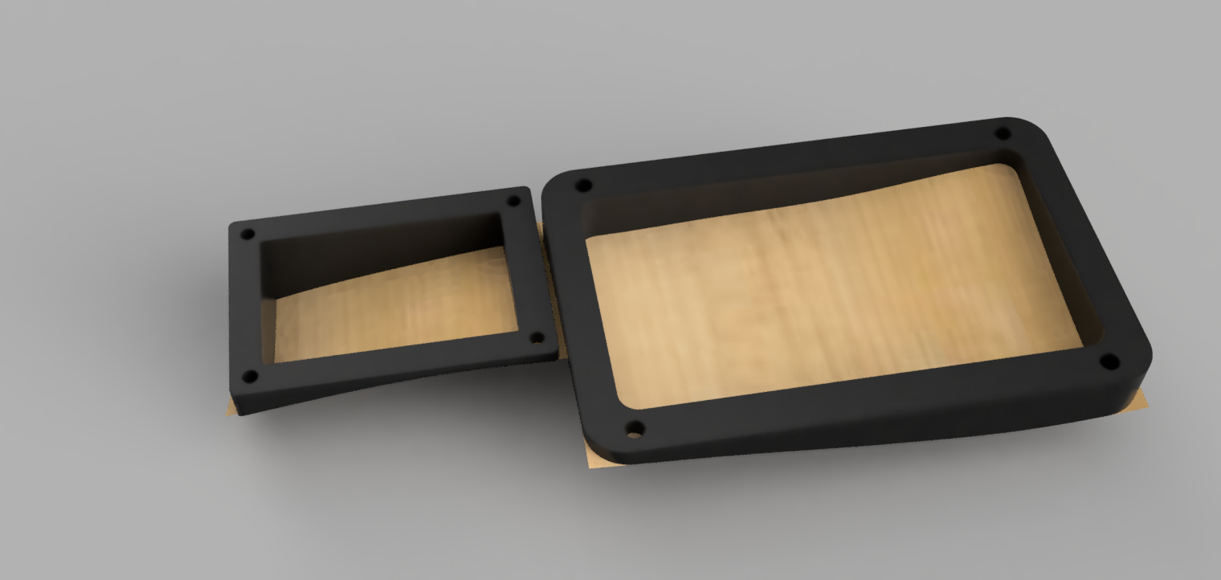
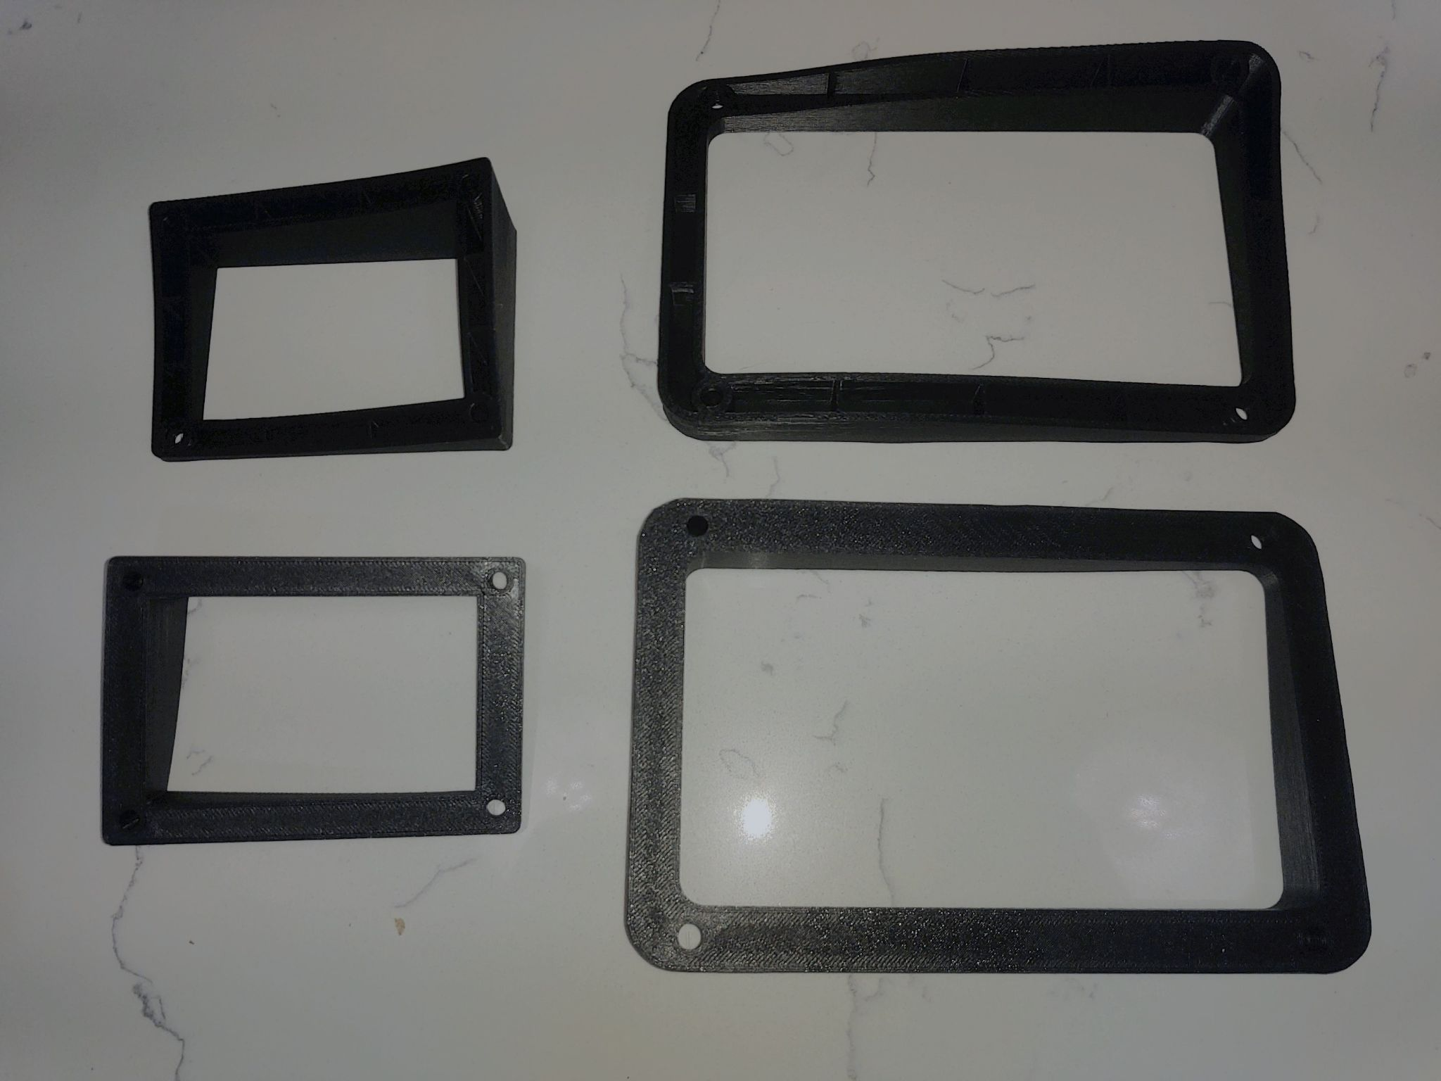
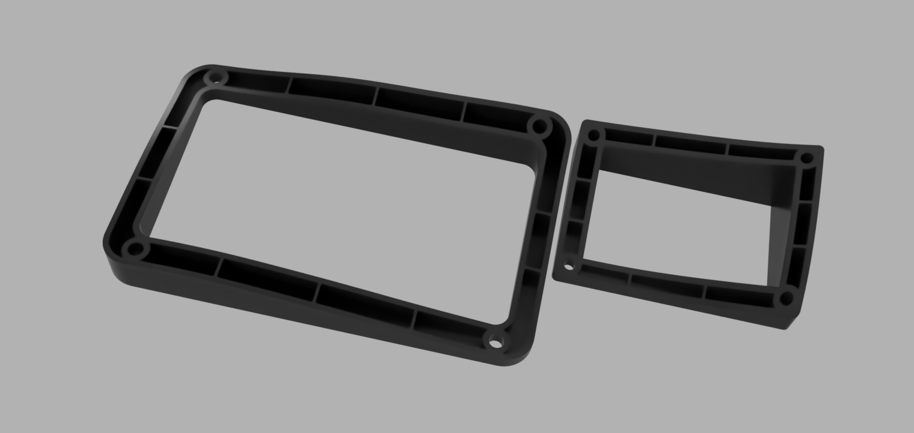
Design Solutions for Edge Vanworks

Slide 18
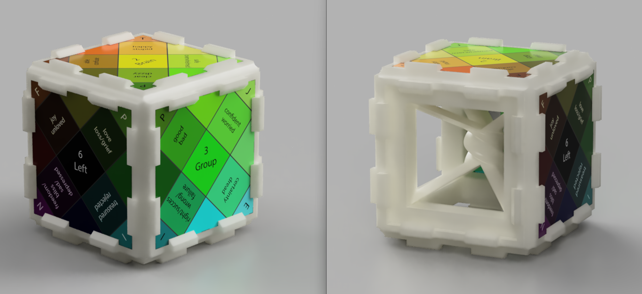
Design Solutions for Gemotions LLC

